Slide 2


Analyzer
BUSINESS
{{startup_name}}
Sector:
CEO:
Investment:
Currency:
Date:
{{Sector}} ·
{{CEO}}
{{inversion_requerida}} ·
{{moneda}}
{{day}}
“Confidential — Do not distribute” (gris 14 pt)
“Prepared by KH Holdings — Strategic Advisory for High-Growth Startups”
“Empowering founders to raise, scale, and close faster.”

Slide 3

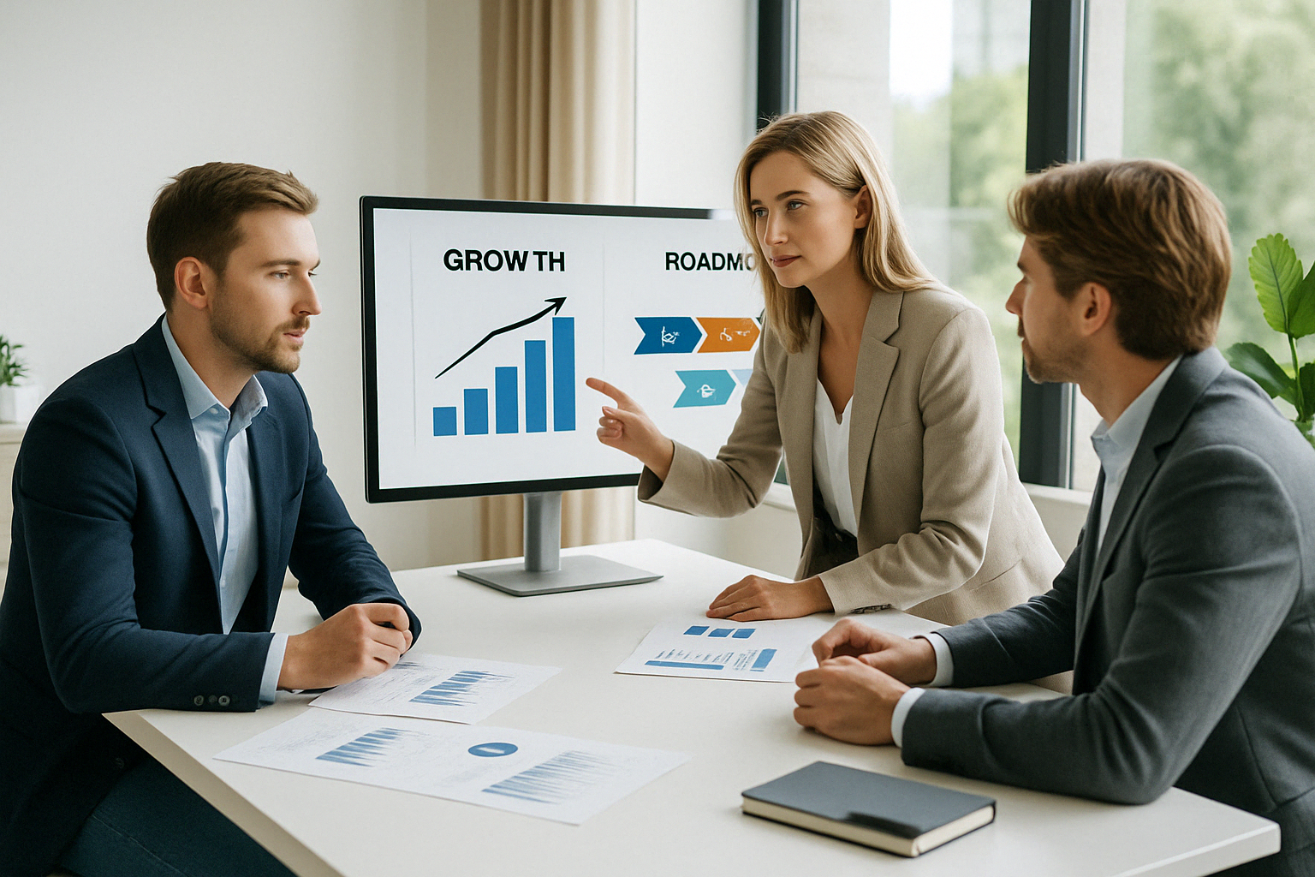
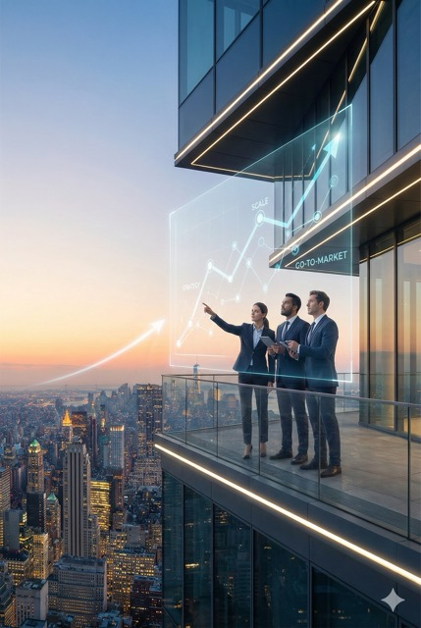
Whether we work together or not, this proposal gives you insights worth reading.
We analyzed your sector to show exactly where value and differentiation can scale fast
Pie de foto

Slide 4
Read This First
Our commitment
You’ll see decision-grade insights, ROI and timelines in 12 slides
Whether we work together or not, we analyzed your sector to show exactly where value and differentiation can scale fast.
Our goal: make you investor-ready, not presentation-
ready.
This framework has powered 70 + startups → €120 M raised through our 3-phase model

Slide 5

OUR 3-PHASE PATH TO FUNDING
Investor-Ready, Not Just Presentation-Ready
Analysis & Structuring
Materials
Placement
Soft Due Diligence (required by funds): We analyze your potential and align it with the market. We turn ideas into a robust business plan and a defensible valuation.
We translate your value into the “investor language.” We create the Investor Pitch Deck and One-Pager designed to spark interest, not to bore with technicalities. And we create and fill Data Room.
We execute the roadshow: we present the opportunity to qualified funds and investors, manage the Q&A, and lead the LOI (Letter of Intent) negotiation through to closing.
Result: A clear strategy.
Result: High-impact tools.
Result: Secured funding

Slide 6
One-Slide Thesis
ALWAYS
{{resumen_valor}}
1
What:
Score:
{{impacto.scoring_total}}
Where
it wins:
{{ventaja_competitiva_breve}}}
2
{{impacto.probabilidad_exito}}
Success probability
{{metodo_prueba_breve}}
3
How we
prove it:
24-month ROI:
{{impacto.roi_proyectado}}

Slide 7


PROBLEM & IMPACT
The Gap We Solve
{{problema_clave}}
“Stakeholders: Founders · Investors · Partners · Clients. Our job: turn problems into investor clarity.

Slide 8

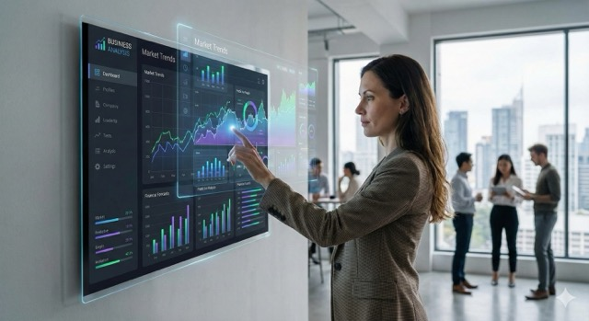
OUR SOLUTION
SNAPSHOT
Core idea:
{{solucion_resumen}}
How it scales:
{{modelo_escala}}
Validated through:
{{validacion_clave}}"
We compress complexity into investor-language clarity in 30 seconds

Slide 9

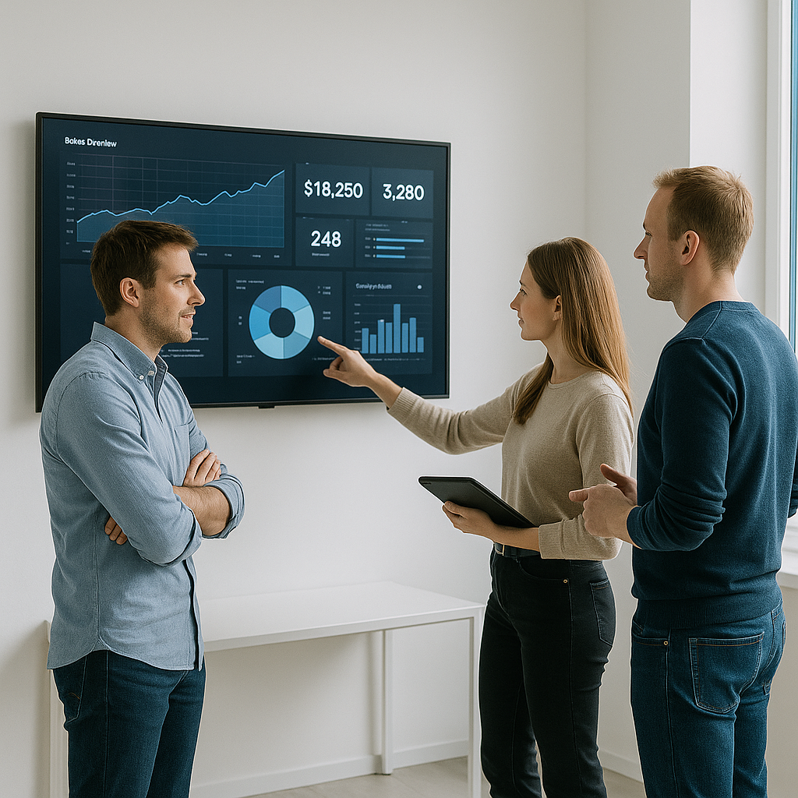
TEAM &
INFRASTRUCTURE
{{team_member_1}} — {{team_role_1}}
{{team_member_2}} — {{team_role_2}}
{{team_member_3}} — {{team_role_3}}
Advised by KH Holdings — Investment Banking & Strategic Growth

Slide 10
MARKET
We blend market data with behavioural economics — not just totals, but traction pathways
{{tam-sam-som}}
TAM
SAM
SOM
{{tTAM}}}
{{SAM}}
{{SOM}}
(Global): {{mercado.TAM}}
(Regional): {{mercado.SAM}}
(Target): {{mercado.SOM}}"
CAGR (5y): {{mercado.CAGR_5y}}
NotaE “Values in EUR, formatted EU style.”

Slide 11

SCORING
TABLE
Scoring Table based on Objective Criterion
Criterion | Description | Peso | Score (0–10) | Scoring
Team & leadership | Execution capacity, credibility, commitment | 3,50 | 9,00 | 31,50
Traction & metrics | Real, sustained growth | 3,00 | 8,00 | 24,00
Business model | Clarity & profitability potential | 3,00 | 9,00 | 27,00
Differentiation | Innovation & defensibility | 3,00 | 9,00 | 27,00
Scalability | Expansion potential | 3,00 | 8,00 | 24,00
Regulatory risk | Exposure & compliance | 2,00 | 7,00 | 14,00
Capital attraction | Fundraising ease & strategic interest | 1,50 | 6,00 | 9,00
Impact & sustainability | ESG/SDG alignment | 1,00 | 9,00 | 9,00
 |  |  | Total Scoring | 165,50
Scoring total:
Success Probability
{{impacto.scoring_total}} /
{{impacto.probabilidad_exito}}
We benchmark narratives vs verifiable capabilities.
Our data is cross-checked against public sources and market validation

Slide 12
COMPETITIVE
LANDSCAPE
Competitive Landscape (Evidence-Based)
Company | Drop-in compatibility | EU production | Lower GWP vs fossil | Price parity | ISCC/REACH ready | Rigid foam focus
Covestro (cardyon, CO₂-based polyols) | ✅ | ❌ | ✅ | ❌ | ✅ | ✅
BASF (BMBcert polyurethane polyols) | ✅ | ✅ | ✅ | ❌ | ✅ | ✅
Dow (RENUVA recycled polyols) | ✅ | ✅ | ✅ | ❌ | ✅ | ✅
Repsol (Reciclex/Recpur polyols) | ✅ | ✅ | ✅ | ❌ | ✅ | ✅
Huntsman (TEROL/circular polyols) | ✅ | ❌ | ✅ | ❌ | ✅ | ✅
Cargill (BiOH natural oil polyols) | ❌ | ❌ | ✅ | ❌ | ✅ | ❌
Superior scalability
Faster validation cycles
High defensibility.
Positioning derived from investor psychology: clarity beats novelty

Slide 13
KPI’s
FORECAST
Short Term
Medium Term
{{kpis_90d_lista}}
{{kpis_180d_lista}}
Milestones linked to evidence creation — not vanity metrics.
Each quarter moves you closer to investor due-diligence readiness.

Slide 14
USE OF
FUNDS
1
Capital allocated to value creation
Every euro spent must accelerate validation or scalability.”
2
3

Slide 15

NEXT
STEPS
Next Steps & Limited-Time Offer
CTA:
Close:
Sign this proposal and Schedule first Meeting with our Analyst to advance fundraising your project
{{proximos_pasos.mensaje_cierre}}

Slide 16

SOURCES &
KH Scoring Model: 8 criteria × weight × evidence = 200 points.”
“Only evidence improves score — not intent.
NOTICES
Internal sources:
Web references:
Disclaimers:
{{fuentes_internas}}
{{urls_referencia}}
{{disclaimers}}
Note: “Evidence links available on request.”

Slide 17

THANK YOU
VISIT US
https://uniasser.com
info@uniassere.com
+34 722 77 40 75

